Slide 1

SYNOPSIS Presentation on
Smart Library Web System
By
Abhishek Sharma (202410116100009)
Abhi Srivastava (202410116100006)
Aachal Kushwaha (202410116100001)
Aayush Sharma (202410116100005)
Session: 2025–2026 (III Semester)
Under the Supervision of: Dr. Shashank Bhardwaj
Department of Computer Applications
KIET Group of Institutions, Delhi-NCR, Ghaziabad – 201206

Slide 2

Project Overview
The Smart Library Web System is a comprehensive digital solution designed to modernise library management. It streamlines core functions while introducing advanced features to enhance the user experience for students and faculty.
Integrated Management
Enhanced Engagement
Digital Accessibility
Efficiently manages book inventory, borrowing, and returns, reducing manual overhead.
Features a review and rating system, fostering community interaction and informed choices.
Provides seamless access to a digital library, expanding learning resources beyond physical books.
Personalised Experience
Automated Alerts
Incorporates a recommendation system to suggest relevant reading materials, promoting deeper engagement.
Includes a crucial late-submission notification system for the HOD, improving resource circulation.

Slide 3
Key Project Objectives
Our primary goal is to create an intuitive and robust system that transforms the traditional library into a dynamic digital hub. These objectives guide our development:
1
Efficient Inventory Management
To develop a system for precise tracking and management of the entire book inventory.
2
Seamless Borrowing & Returns
To implement a user-friendly system for students to borrow and return books effortlessly.
3
Interactive Review & Rating
To integrate a feature allowing users to review and rate books, enhancing community engagement.
4
Accessible Digital Library
To provide secure access to digital resources and e-books for all registered users.
5
Personalised Recommendations
To develop an intelligent recommendation engine for tailored reading suggestions based on user preferences.
6
HOD Notification System
To automate alerts for the HOD regarding overdue book submissions, ensuring timely returns and availability.

Slide 4

Project Scope: Included Modules
The Smart Library Web System focuses on core functionalities crucial for modern academic library operations. Below are the key modules within our development scope:
Book Inventory Management: Comprehensive cataloguing, adding, and removing books, including their availability status.
Digital Library Module: Access to e-resources, journals, and other digital content, securely managed within the system.
Borrowing & Returning System: Streamlined process for students to check out and return physical books, with automated tracking.
Recommendation System: An algorithm-driven feature suggesting books based on reading history, popular choices, and categories.
Student Reviews & Ratings: Functionality for users to provide feedback and rate books, displayed publicly for other users.
Late Submission Alerts (HOD Notification): Automated email or in-system notifications sent to the HOD for overdue books.

Slide 5

Methodology: Waterfall Model & MERN Stack
Our project employs the Waterfall Model for its structured approach, ensuring clarity and sequential progression through development phases. This is complemented by the powerful MERN stack, providing a robust full-stack solution.
01
Requirement Analysis
Detailed collection and documentation of all functional and non-functional requirements.
02
System Design
Designing the system architecture, database schema, and user interface layouts.
03
Module Development
Individual module coding using MERN technologies, focusing on clean and efficient code.
04
Integration & Testing
Combining developed modules and rigorous testing to identify and rectify defects.
05
Deployment & Documentation
System deployment to a live environment and comprehensive project documentation.

Slide 6
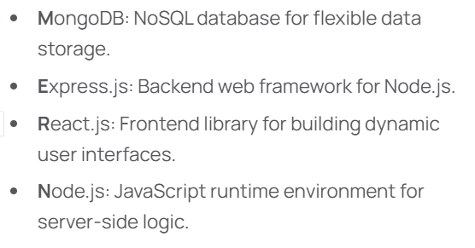

Technology Stack

Slide 7
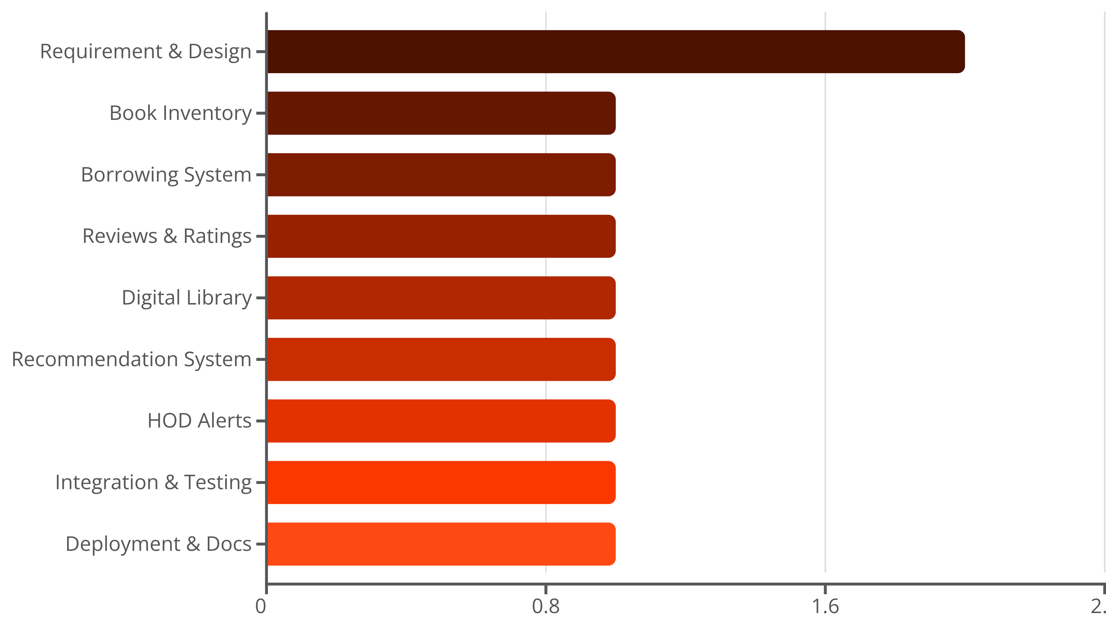
Project Timeline: 10-Week Gantt Chart
Our project is structured into a 10-week development cycle, ensuring systematic progress and timely completion of all modules.

Slide 8




Expected Project Outcomes
Upon successful completion, the Smart Library Web System will deliver significant improvements in library operations and user engagement, leveraging the full capabilities of the MERN stack.
Fully Functional Web System
Operational Digital Library & Recommendations
A complete, responsive Smart Library Web System built with MongoDB, Express.js, React.js, and Node.js.
Seamless access to e-resources and an active recommendation system for personalised suggestions.
Automated Late Return Alerts
Improved Accessibility & Efficiency
An efficient notification system alerting the HOD for overdue books, reducing manual follow-ups.
Enhanced resource accessibility for students and streamlined operational efficiency for library staff and faculty.

Slide 9

Thank You
Questions & Discussion

